Slide 1
Communicating the value of statistics to decision makers
María Jesús Vinuesa
Official statistics: New opportunities for transformation – innovation and cooperation
Budapest, 20- 21 October 2015

Slide 2
We are not alone
1. Alternative data sources
2. Other Data
Providers
DATA REVOLUTION

Slide 3
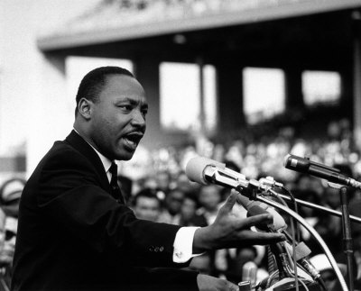
CHALLENGE
Maintain and highlight the value of Official
Statistics
and COMMUNICATE them!!!

Slide 4
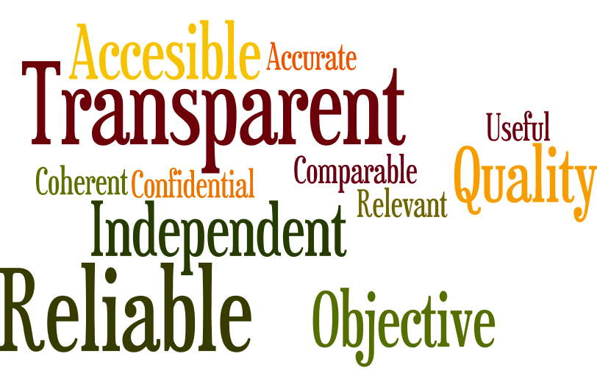
The Value of Official Statistics:
BRANDING
We need to ensure that the Brand of “official Statistics” is well-recognized

Slide 5
Is Branding a good idea?
Volkswagen Group
Domino effect: if one falls over, the next falls down too

Slide 6
HOW?
Branding: “Official Statistics”
Communication and marketing strategy
Work in cooperation to identify best practises
Actively promote re-dissemination by third parties (twitter, Facebook, workshop with data journalist..)
National Conferences for users of European statistics
(Riga and Luxembourg 2015)
DIGICOM project

Slide 7
HOW?
Improve Statistical Literacy
Special days like the World Statistics Day
Press conferences
Magazines
Competitions: Statistics Olympiads, Hackathons

Slide 8
Take advantage of every situation to communicate our values

