Slide 1
New methods of communicating statistics
21/10/15 – Henriette de Jong

Slide 2
7 pillars of news
http://youtu.be/0NLfjlP5Fxc
Timeliness
Proximity
Rarity
Prominence
Impact
Novelty
Human interest

Slide 3
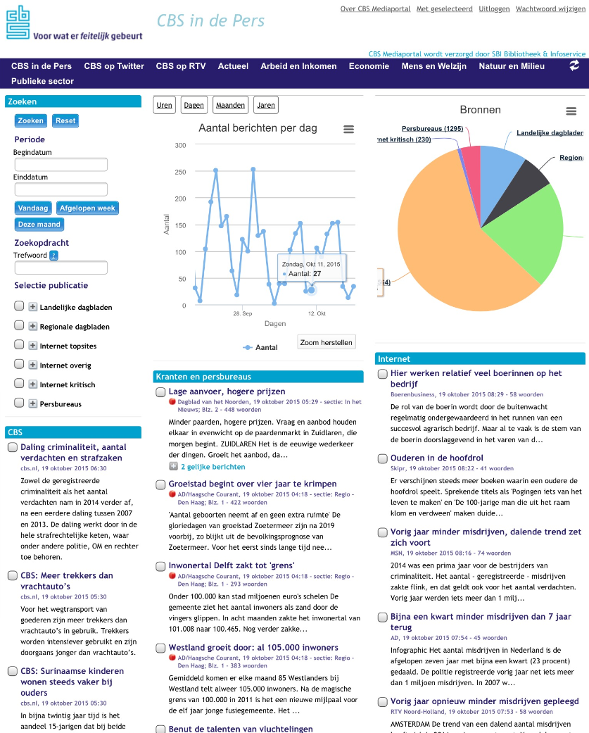
Media portal

Slide 4
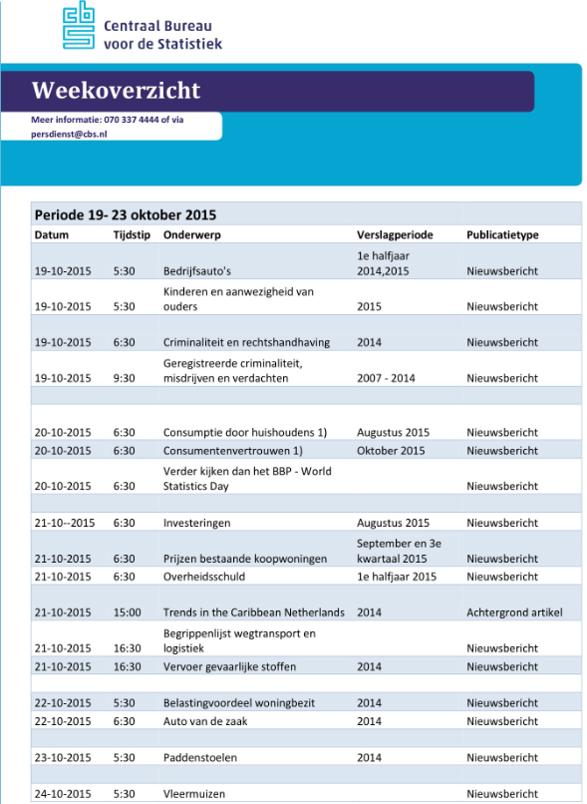
Timing

Slide 5
Storytelling
Mono-statistics are still important but:
Storytelling is the new method to show what’s happening in society
Visuals: pictures, infografics

Slide 6
Website

Slide 7
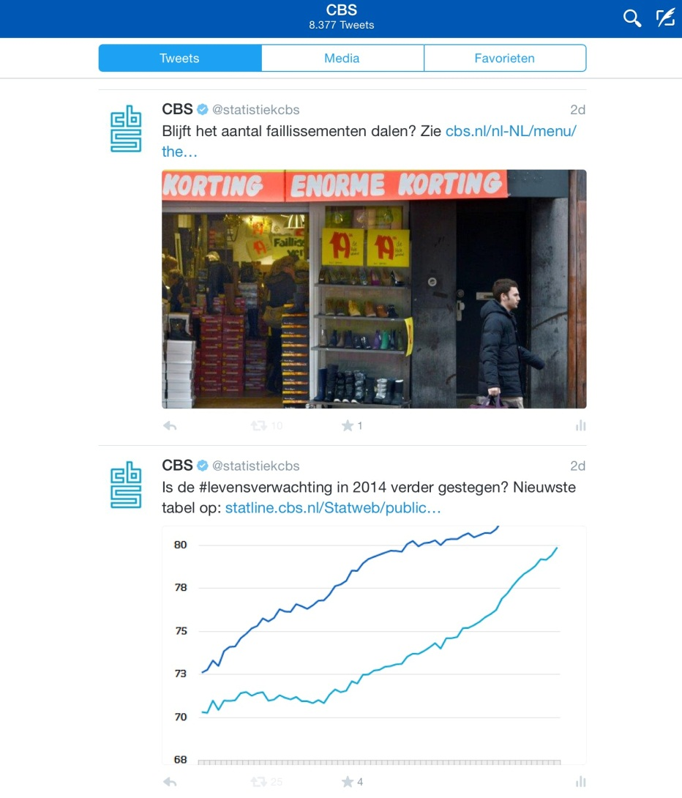
Social media
Since September 2009
Followers: 104K
Verified account
175K impressions/day
985 link clicks/day
170 retweets/day
24 replies/day

Slide 8
Press conference
Trends instead of numbers
What’s going on in the Netherlands?

Slide 9
Conclusions
Communication brings statistics to live
It is like a news agency with its own data sources
Everyday statistics are important

