Slide 1
Exchange of micro-data for statistical purposes: from risk identification to risk mitigation
Walter J. Radermacher
Director-General of Eurostat
Budapest, 20 October 2015

Slide 3
Drivers
Globalisation
Data Revolution
Modernisation
Legislation
Governance
Quality
Risks
Costs
Burden

Slide 4
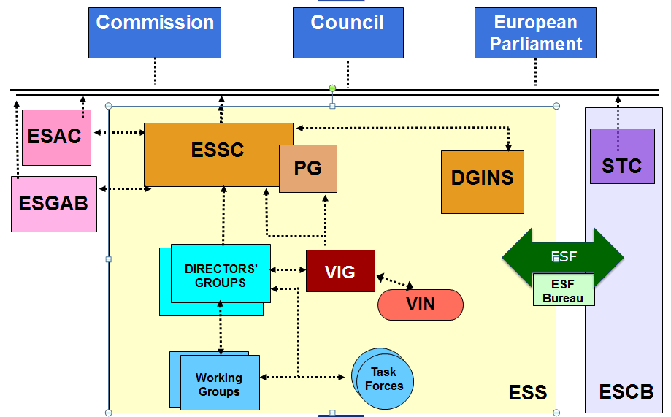
ESS 2015

Slide 5
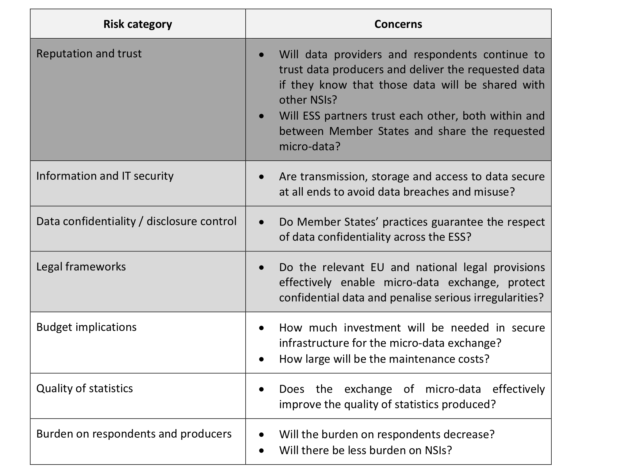
Risks

Slide 6
Trust
Trust between different actors cannot be established and maintained without building up of everyone's good reputation and without additional safeguards, e.g. legislation, codes of conduct, written commitments, peer reviews, audits, metadata, technical data security arrangements etc., depending on the actors involved and the stage of the (micro-) data life cycle. Therefore building trust is an essential part of risk response strategy that needs to be undertaken by the ESS.

Slide 7
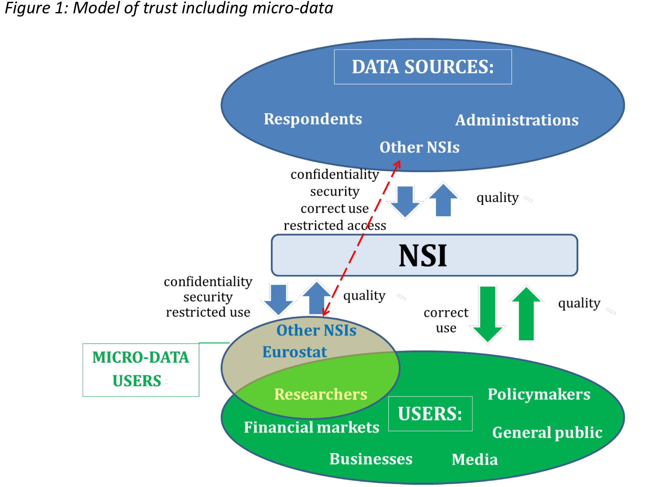

Slide 9
Quality (Art. 18 Reg. 223)
Relevance
Accuracy
Timelines
Punctuality
Accessibility and Clarity
Comparability
Coherence

Slide 10
Quality (Art. 18 Reg. 223)
Relevance
Accuracy
Timelines
Punctuality
Accessibility and Clarity
Comparability
Coherence

Slide 11
Conditions for success: ∑
Inner circle of trust for selected statistics
Principles / legislation / governance defining roles, obligations and rights for an ESS data space
To be included in Reg 223 as component of ESS
Context: micro-data exchange in other areas (tax, …), EU data protection, ECJ judgement

