Slide 1
Sustainability of Statistics/
Statistics of Sustainability
Barteld Braaksma

Slide 2
Sustainability of Statistics
Lots of existing information can be used better…
New sources are waiting to be explored…
Statistical literacy becomes essential!
And we need all kinds of partners
We practice what we preach ☺
So, how to deal with the new challenges?
Be proactive and innovate!

Slide 3
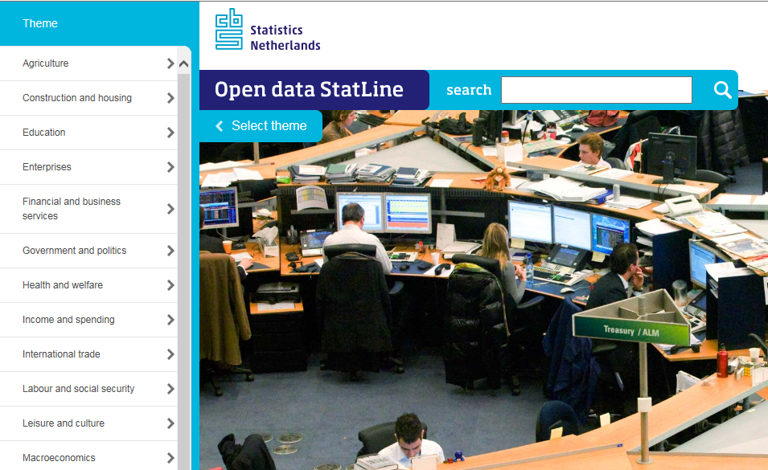
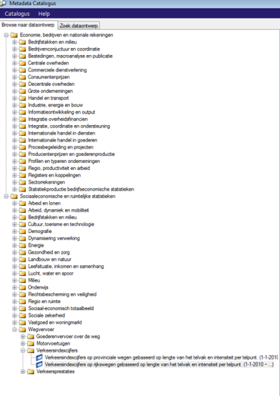
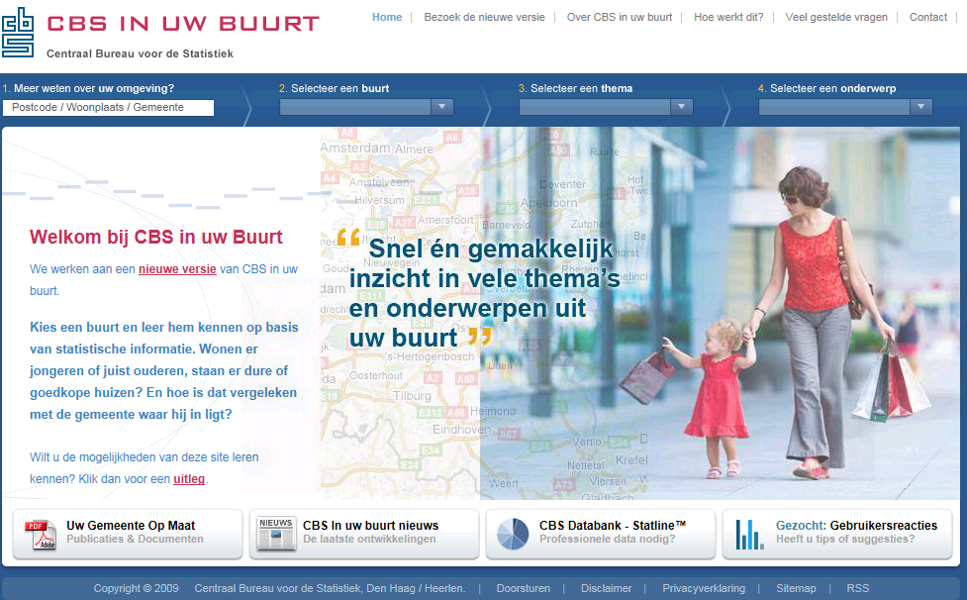
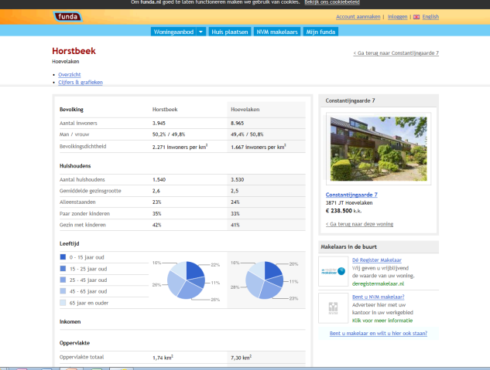
Lots of existing information can be used better…
Open data
Catalogue
Catalogue:
771 datadesigns
1258 datasets
14782 variables
Site with houses for sale integrates CBS data
Thematic CBS site with local data

Slide 4
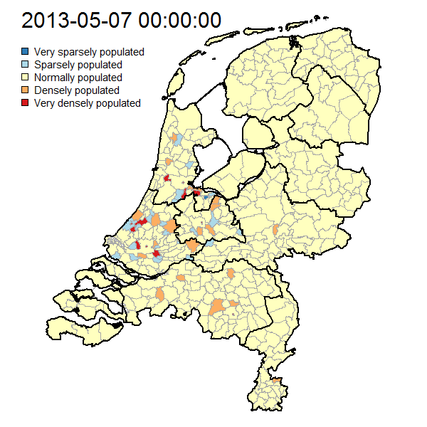
New sources are waiting to be explored…
Daytime whereabouts from mobile phone data
What information do users want?
What quality?
Towards (near) real-time?
Could we produce local or thematic indicators from social media?
Sentiment from social media

Slide 5
Statistical literacy becomes essential!
Hal Varian ‘on workers and managers’ in
The McKinsey Quarterly, Januari 2009:
I keep saying the sexy job in the next ten years will be statisticians (…)
Because now we really do have essentially free and ubiquitous data. So the complimentary scarce factor is the ability to understand that data and extract value from it.
I think statisticians are part of it. (…)
Managers need to be able to access and understand the data themselves.
Chief economist at Google
Emeritus professor at Berkeley
BB: this will be our job…

Slide 6
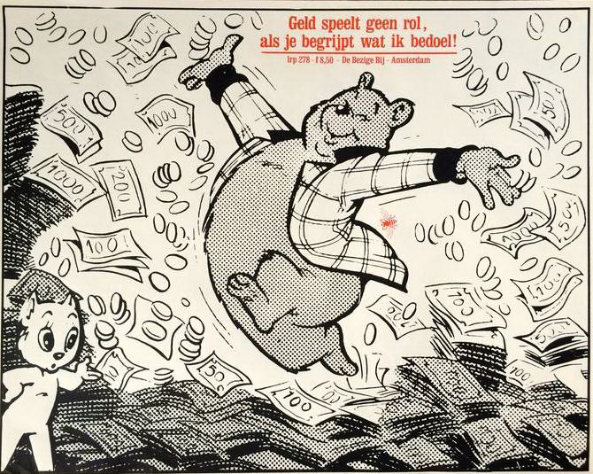
And we need all kinds of partners
We have something to offer
Data, expertise, and reputation
We love to share ☺
We can’t do it alone (anymore): find common goals!
International statistical community
Knowledge partners
IT partners
Data owners
Users
Money always matters ☹

Slide 7
We practice what we preach ☺
Smart cities
with The Hague, Rotterdam, Zwolle, …
Cross-border statistics
Pilot project with DG Regio and several statistical and research partners
Digital economy
With Google and www.dataprovider.com
Personalised health
With TNO, Wageningen University and commercial partners
Data Camp
With Twente University

Slide 8
So, how to deal with the new challenges?
Develop new products and services
Tailor-made statistics, trusted third party, visualisations, …
Users are not stupid
So let’s speak with them!
Beware of pseudo-information from unclear origin
We warned for 21minutes.nl: a Dutch web survey with political impact
We have to become more agile
Produce stable outputs from unstable and ever changing inputs
Commercial market researchers face similar issues
Nowadays, their offers are judged by the financial departments
We must manage expectations
Gartner hype cycle
We should generate more resources
Funding, co-creation, delegated work
Be proactive, and innovate
Move from data collectors to information providers

Slide 9
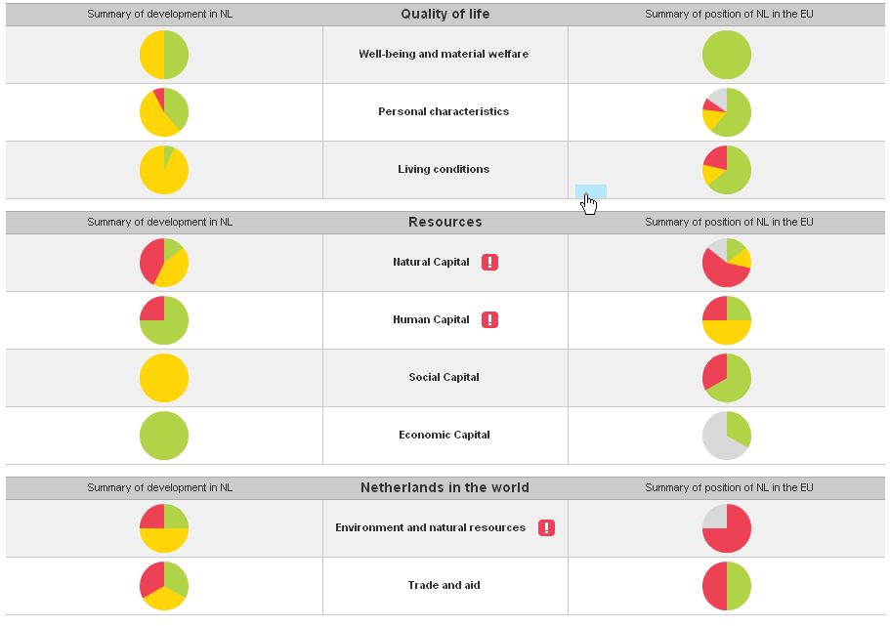
Statistics of Sustainability
Sustainability important theme for CBS
Conceptual work on sustainability framework/Capital approach
Here and now, later, elsewhere
Compilation of National Sustainability Monitor

Slide 10
The way ahead (1)
Traditional statistics not sufficient for SDG purposes
Too limited
Too slow
Too expensive
Especially in least developed countries
Leadership from official statistics in defining indicators
With a focus on practical application
Coherent framework instead of isolated indicators
To enhance analytical opportunities
Need to exploit new methods and sources (‘Data revolution’)
By relying on mobile devices, satellite data, crowd sourcing, …

Slide 11
The way ahead (2)
Available capacity not sufficient for SDG purposes
Number of staff too small
Experienced people too busy
Too little money
Especially in least developed countries
Partnerships to operationalize indicators
By mobilising commercial and research organisations to work for the public good
Transfer knowledge
Through liaisons with local partners in less developed countries
Learn from consultants’ approach
By letting experienced seniors work with energetic juniors

